Slide 1
DevSecOps
Bring Security practices earlier in your DevOps process

Slide 2
days
the time it takes for a vulnerability to be exploited
Source: Sonatype. State of the Software Supply Chain. 2020

Slide 3




The threat landscape
is changing
Vulnerable developer secrets
Vulnerable DevOps Pipeline
Vulnerable supply chain
Vulnerable code and containers

Slide 4
It’s time to shift security left and unite teams
62%
60x
of enterprises do not integrate security in the development phase
average security cost to fix a security defect in production versus in development
¹Sources: McKinsey Developer Velocity, Microsoft Enterprise DevOps Report, GitHub Octoverse Report 2020
²https://www.gartner.com/doc/reprints?id=1-265CMWW4&ct=210527&st=sb

Slide 5
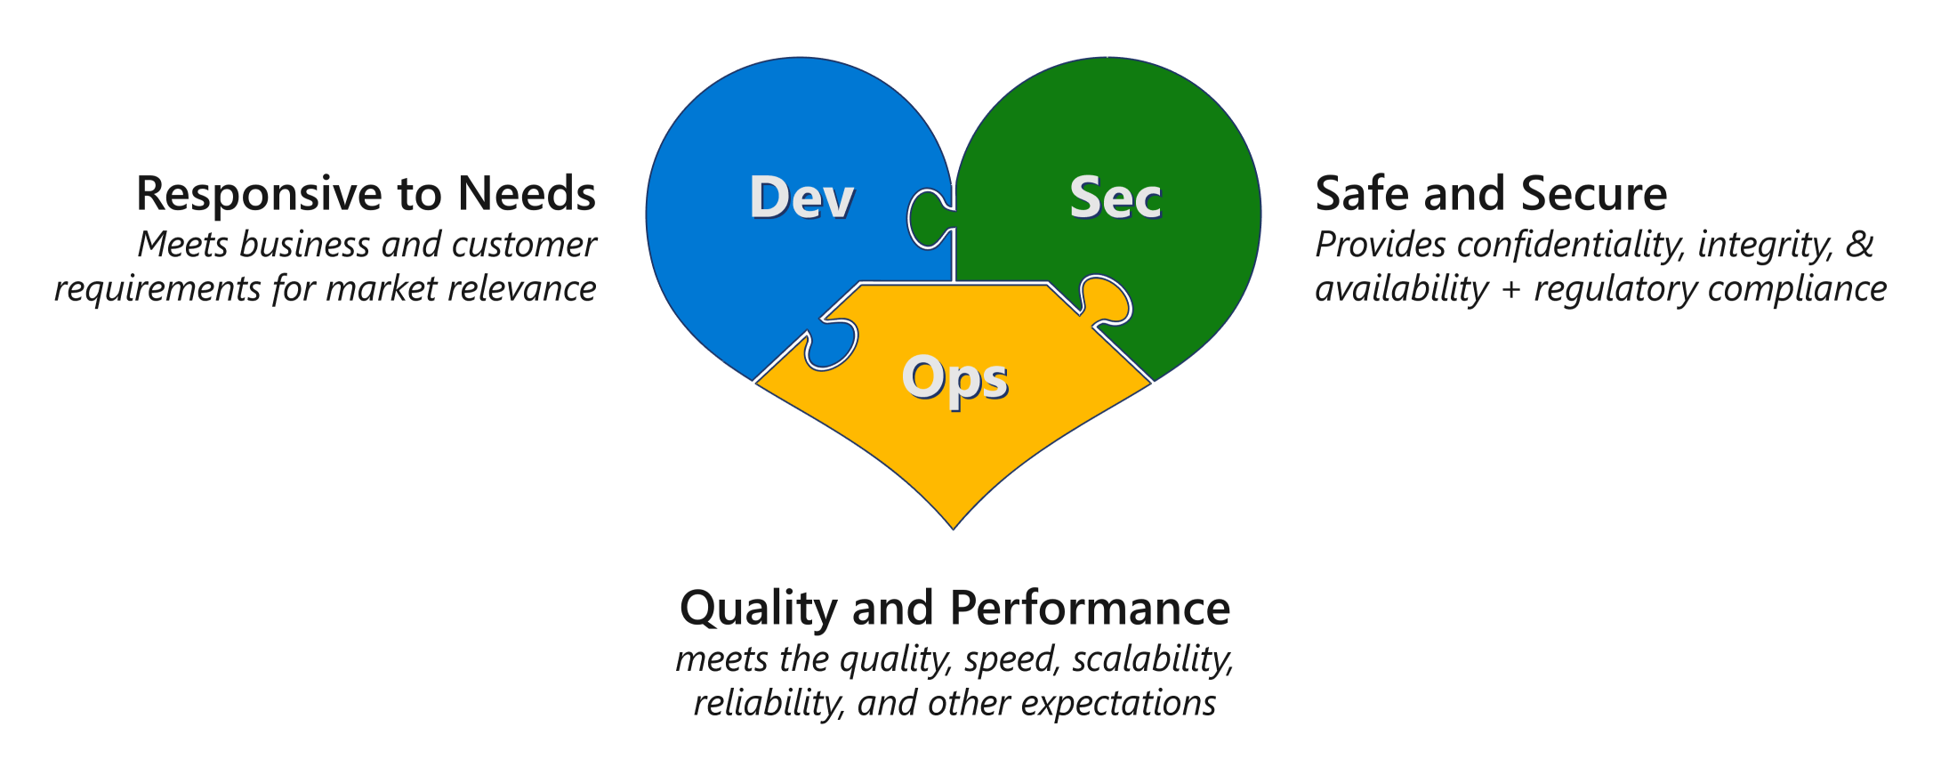
DevSecOps
Innovation security - Cloud Adoption Framework | Microsoft Docs

Slide 6
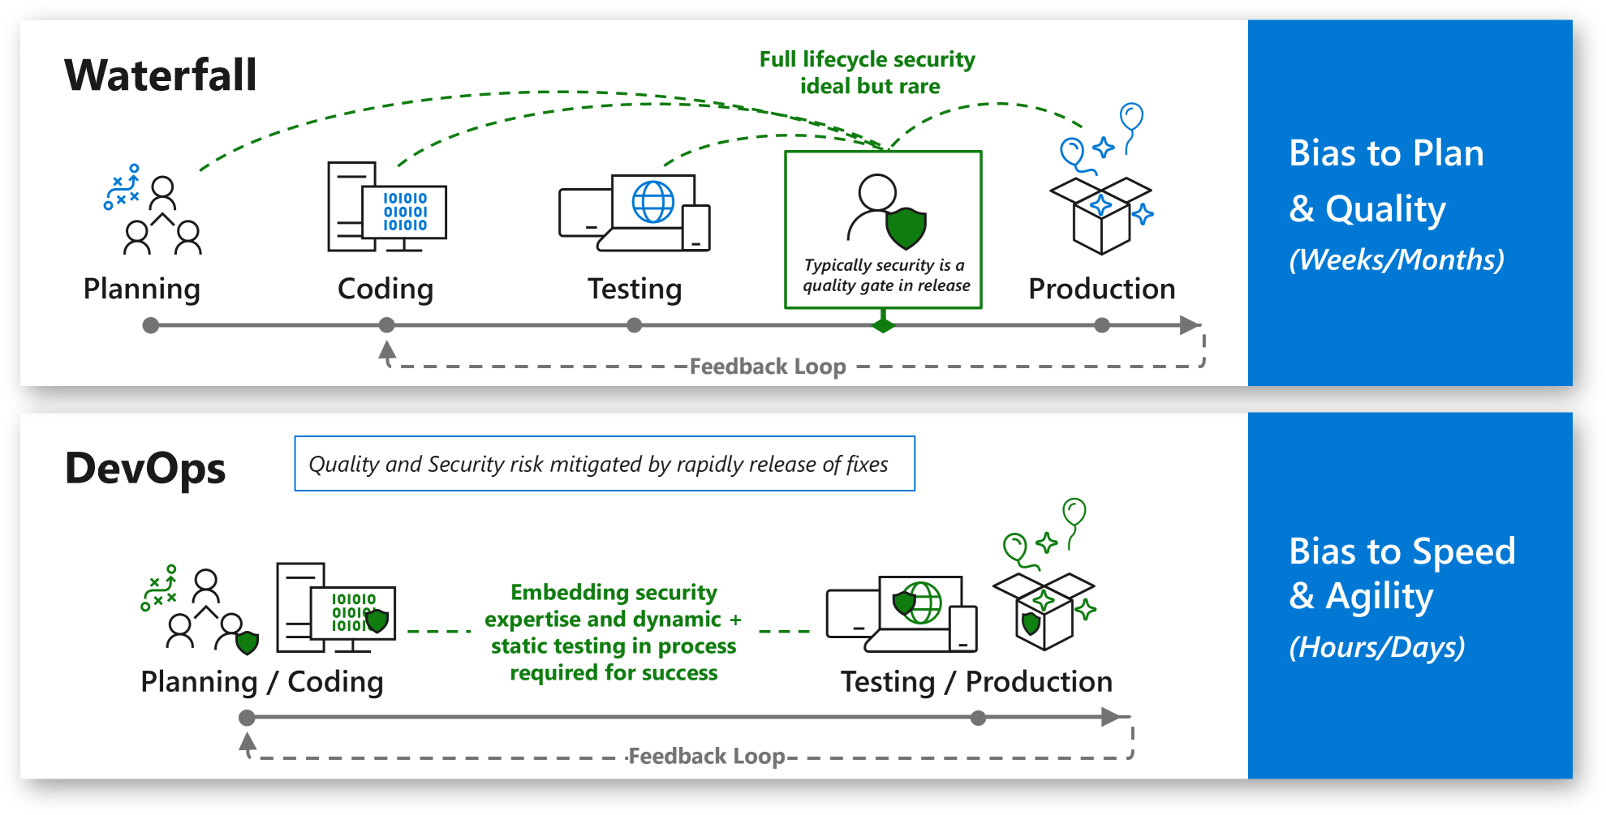
Secure by Design and Shifting Left

Slide 7
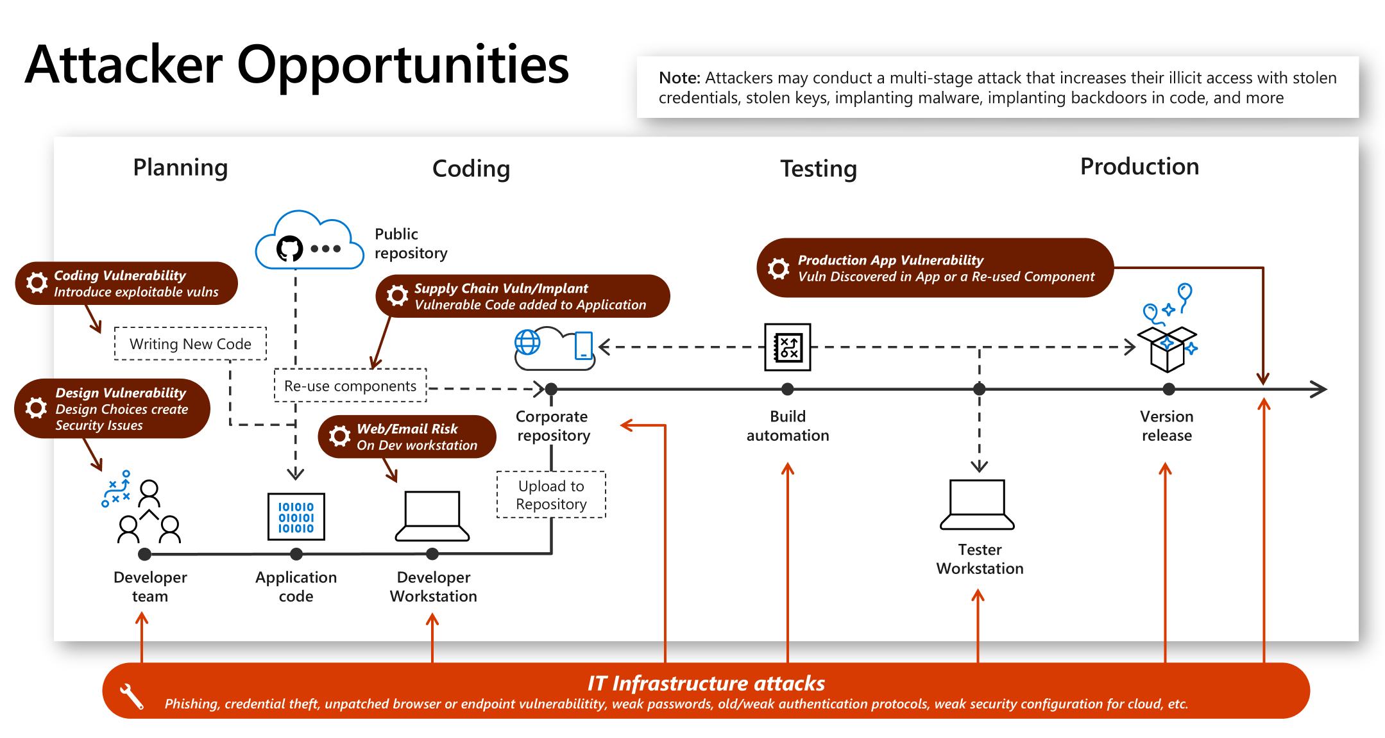
Attacker Opportunities

Slide 8
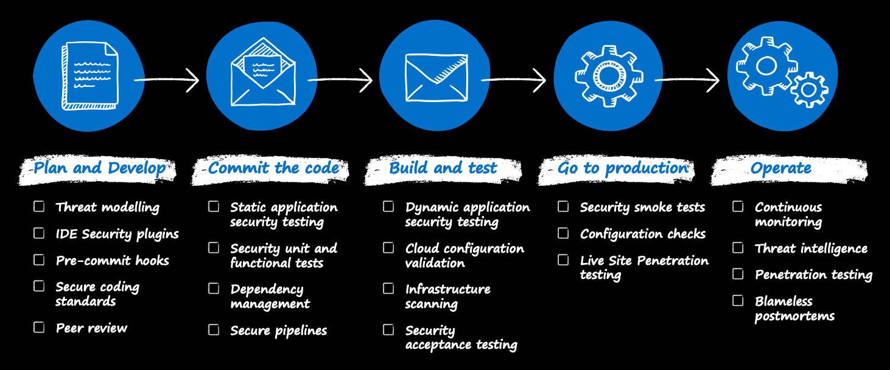
DevSecOps Controls
DevSecOps controls - Cloud Adoption Framework | Microsoft Docs

Slide 9
DevSecOps Controls
DevSecOps controls - Cloud Adoption Framework | Microsoft Docs

Slide 10
Threat modelling
Stride
Spoofing
Tampering
Repudiation
Information Discosure
Denial of Service
Elevation of Privileges

Slide 11
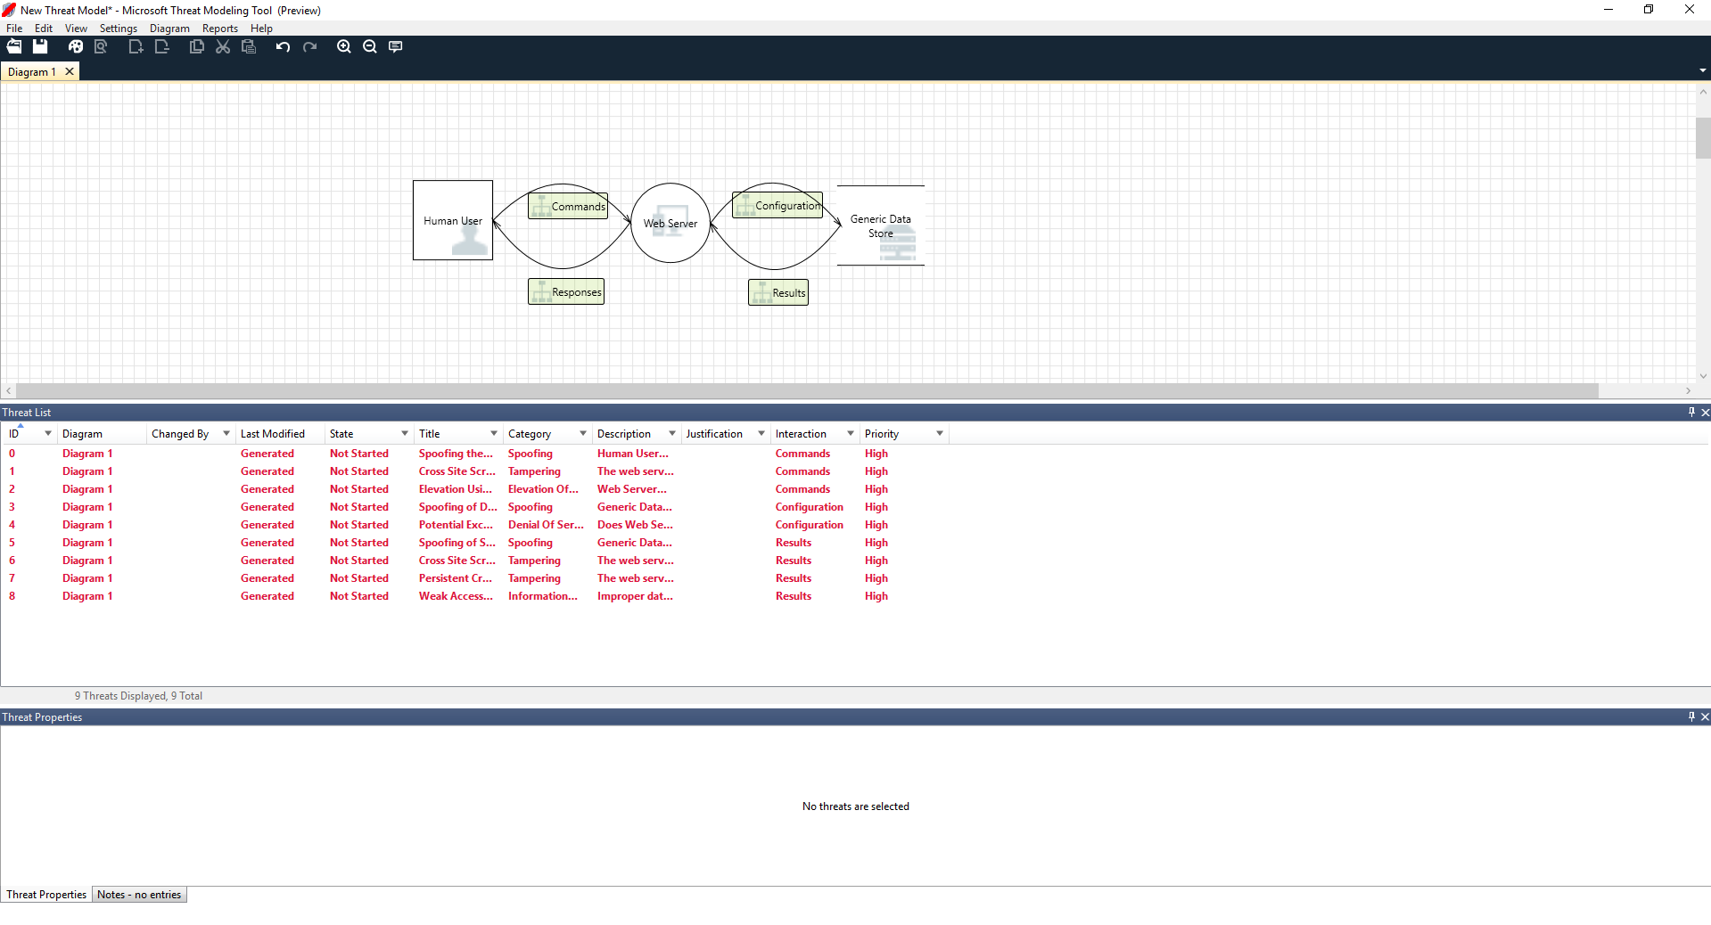
Microsoft Thread Modelling Tool
Getting Started - Microsoft Threat Modeling Tool - Azure | Microsoft Docs
Simple questions method | Microsoft Docs
A Guide to Threat Modelling for Developers (martinfowler.com)
Microsoft Security Development Lifecycle

Slide 12
DevSecOps Controls
DevSecOps controls - Cloud Adoption Framework | Microsoft Docs

Slide 13
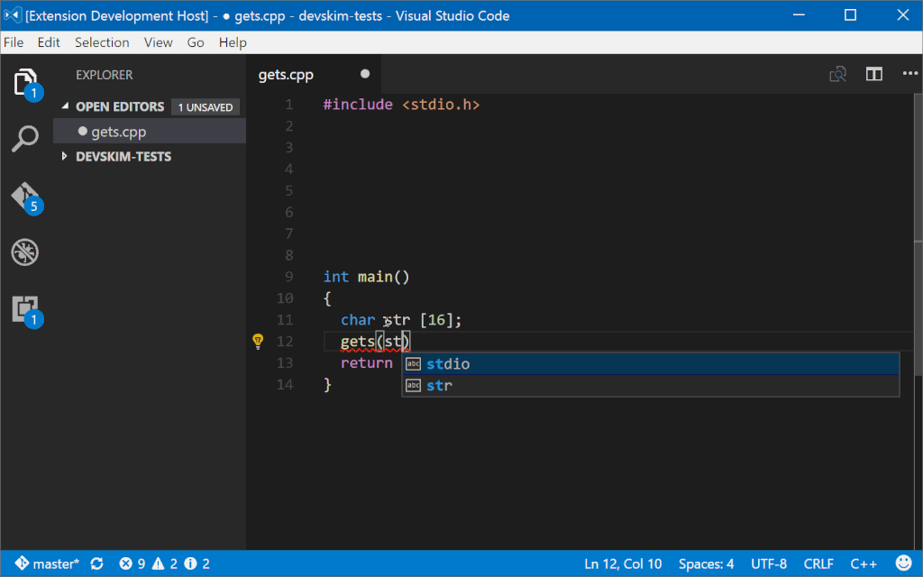
DevSkim
https://github.com/Microsoft/DevSkim
Search results - tag:Security | Visual Studio , Visual Studio Marketplace

Slide 14
DevSecOps Controls
DevSecOps controls - Cloud Adoption Framework | Microsoft Docs

Slide 15
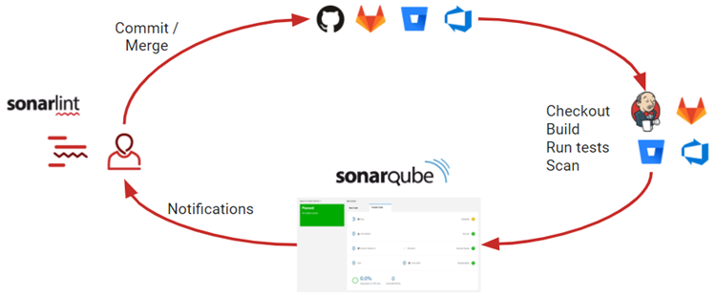
SonarQube
SonarQube Documentation | SonarQube Docs
BinSkim
Security Code Scan (security-code-scan.github.io)
CredScan
Microsoft Security Development Lifecycle Resources
Source Code Analysis Tools | OWASP
Add Key Vault support to your ASP.NET project using Visual Studio - Azure Key Vault | Microsoft Docs
Managed identities for Azure resources | Microsoft Docs

Slide 16
DevSecOps Controls
DevSecOps controls - Cloud Adoption Framework | Microsoft Docs

Slide 17
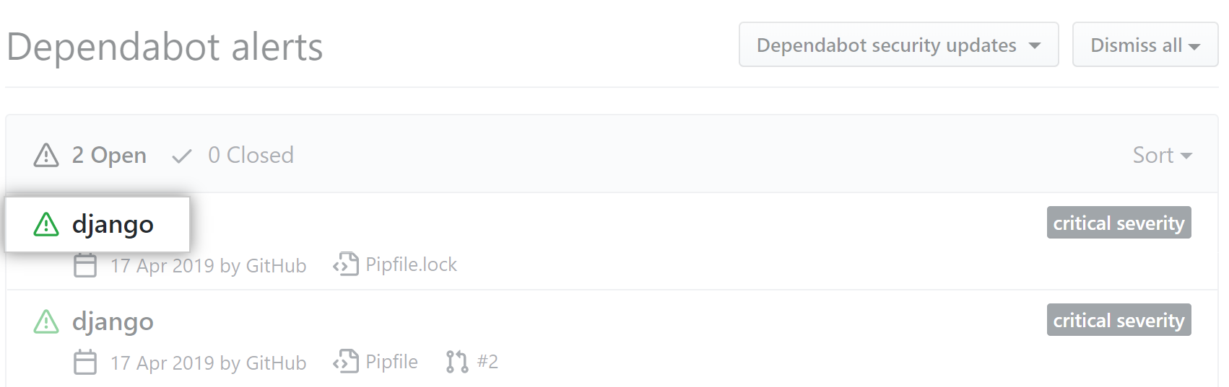
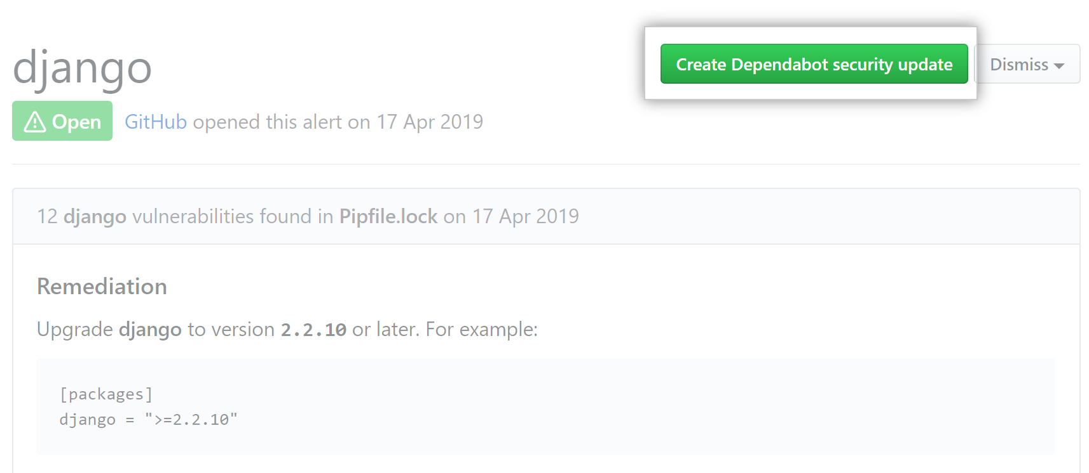
Dependabot
About the dependency graph - GitHub Docs
dependabot/dependabot-core: 🤖
OWASP Dependency-Check Project | OWASP

Slide 18
DevSecOps Controls
DevSecOps controls - Cloud Adoption Framework | Microsoft Docs

Slide 19
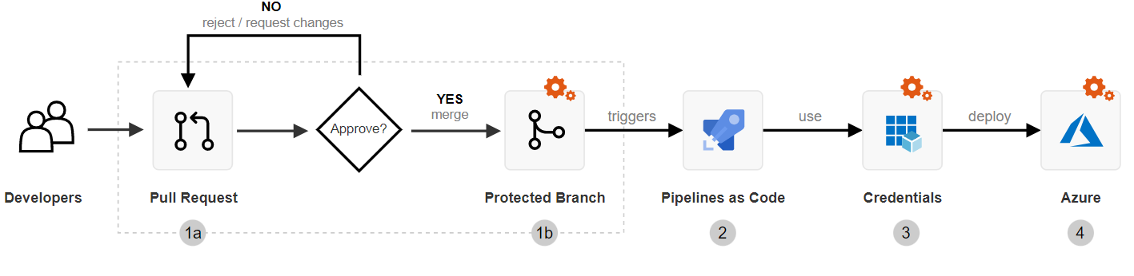
Secure the pipeline and CI/CD flow
Repository protection
Pipeline resources
Project structure
Security through templates
Variables and parameters
Shared infrastructure
Other security considerations
Secure DevOps - Cloud Adoption Framework | Microsoft Docs
Securing Azure Pipelines - Azure Pipelines | Microsoft Docs

Slide 20
DevSecOps Controls
DevSecOps controls - Cloud Adoption Framework | Microsoft Docs

Slide 21
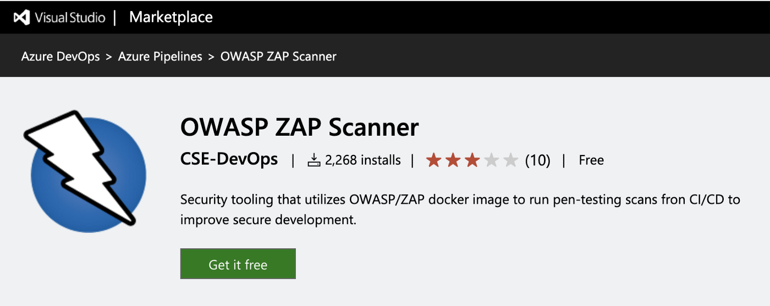
OWASP Zed Attack Proxy (ZAP)
OWASP ZAP – Automate ZAP (zaproxy.org)
OWASP ZAP Security Tests in Azure DevOps | by Manas Peçenek | adessoTurkey | Medium
Azure DevOps Pipelines: Leveraging OWASP ZAP in the Release Pipeline - Developer Support (microsoft.com)

Slide 22
DevSecOps Controls
DevSecOps controls - Cloud Adoption Framework | Microsoft Docs

Slide 23
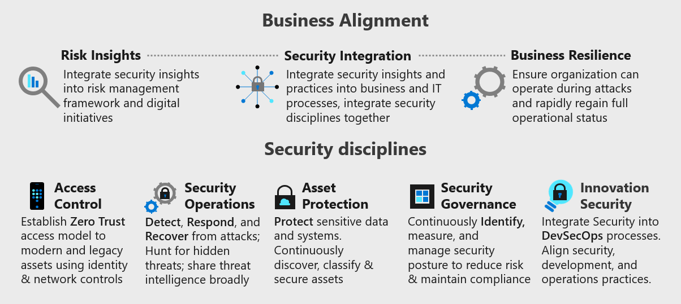
CAF – ESLZ – Azure Policies
Microsoft Cloud Adoption Framework for Azure - Cloud Adoption Framework | Microsoft Docs
Security in the Microsoft Cloud Adoption Framework for Azure - Cloud Adoption Framework | Microsoft Docs

Slide 24
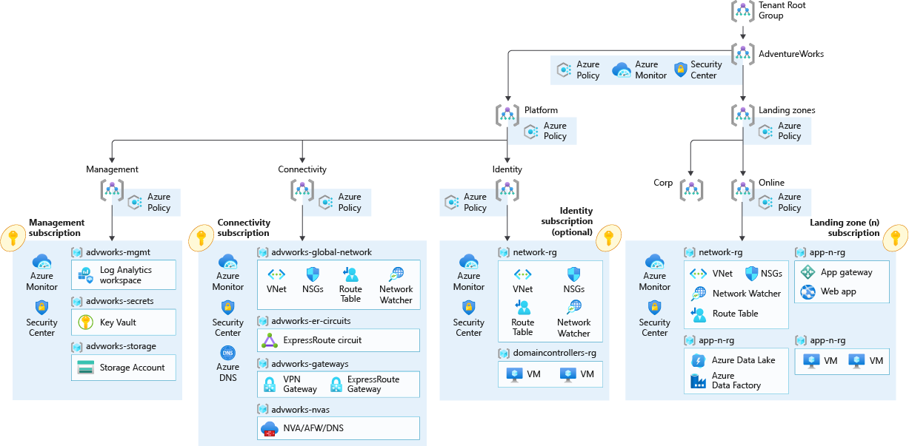
CAF – ESLZ – Azure Policies
Start with Cloud Adoption Framework enterprise-scale landing zones - Cloud Adoption Framework | Microsoft Docs
Implement Cloud Adoption Framework enterprise-scale landing zones in Azure - Cloud Adoption Framework | Microsoft Docs

Slide 25
DevSecOps Controls
DevSecOps controls - Cloud Adoption Framework | Microsoft Docs

Slide 26
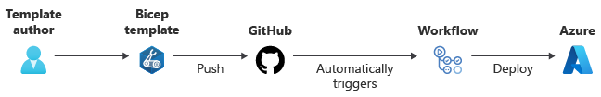
Infrastructure Scanning
Azure/arm-ttk: Azure Resource Manager Template Toolkit (github.com)
tfsec | A static analysis security scanner for your Terraform code. Discover problems with your infrastructure before hackers do.
How to validate terraform script and run security static code analysis as a part of Azure DevOps CI/CD pipeline (winopsdba.com)
learnbicep

Slide 27
DevSecOps Controls
DevSecOps controls - Cloud Adoption Framework | Microsoft Docs

Slide 28
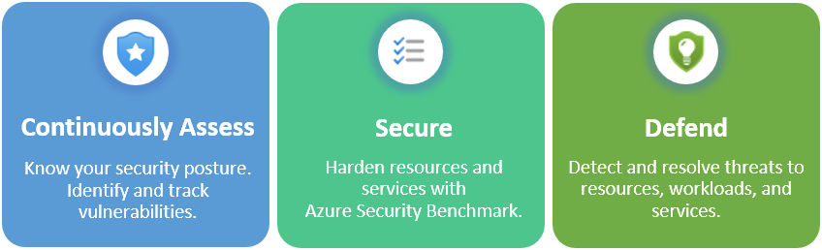
Configuration Checks
Microsoft Defender for Cloud - an introduction | Microsoft Docs
azsk/AzTS-docs (github.com)

Slide 29
DevSecOps Controls
DevSecOps controls - Cloud Adoption Framework | Microsoft Docs

Slide 30
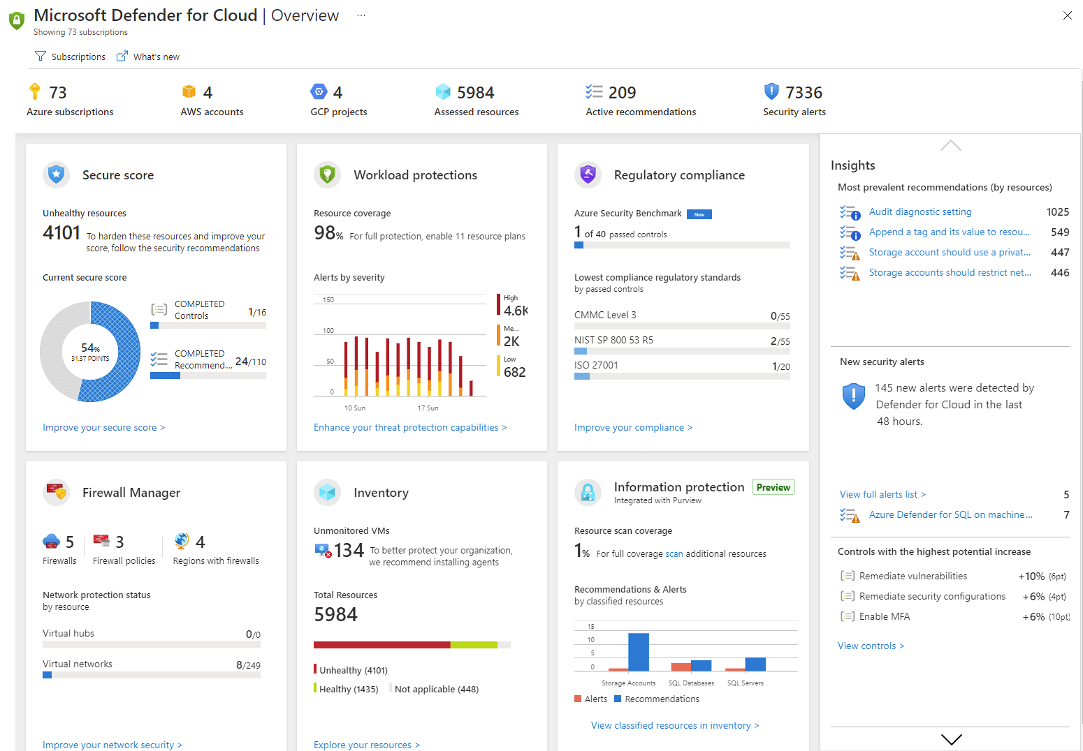
Continuous Monitoring
Microsoft Defender for Cloud - an introduction | Microsoft Docs
Azure threat protection | Microsoft Docs

Slide 31
End to End Control

Slide 32
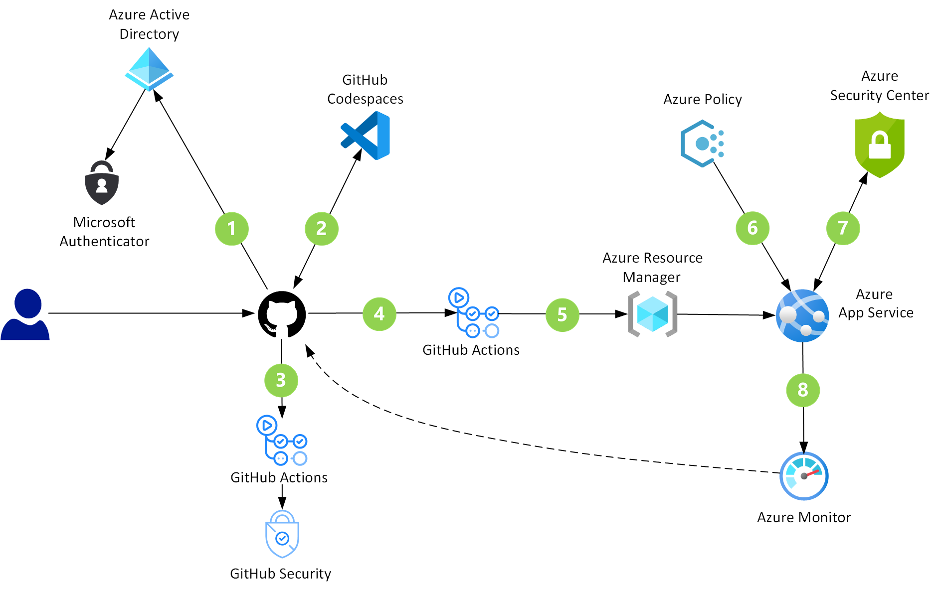
DevSecOps in GitHub
DevSecOps in GitHub - Azure Solution Ideas | Microsoft Docs

Slide 33
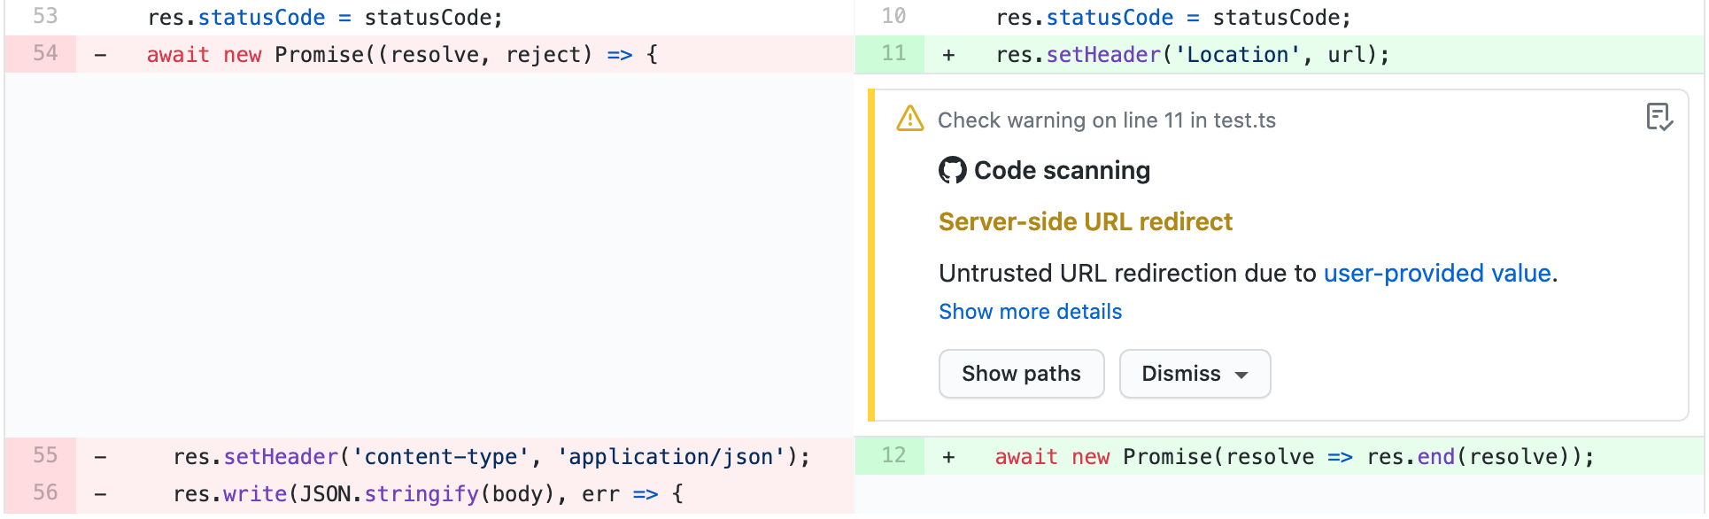
DevSecOps in GitHub
About code scanning - GitHub Docs

Slide 34
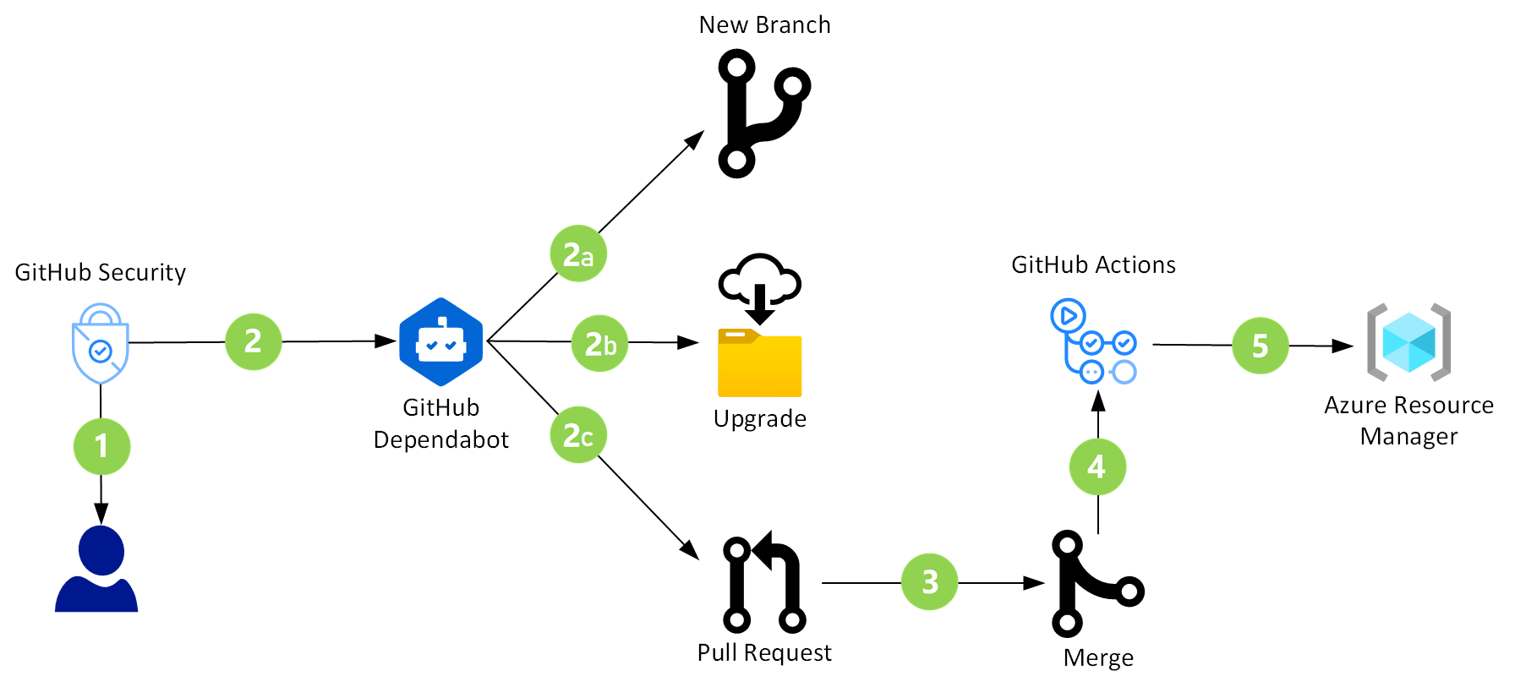
DevSecOps in GitHub
DevSecOps in GitHub - Azure Solution Ideas | Microsoft Docs

Slide 35
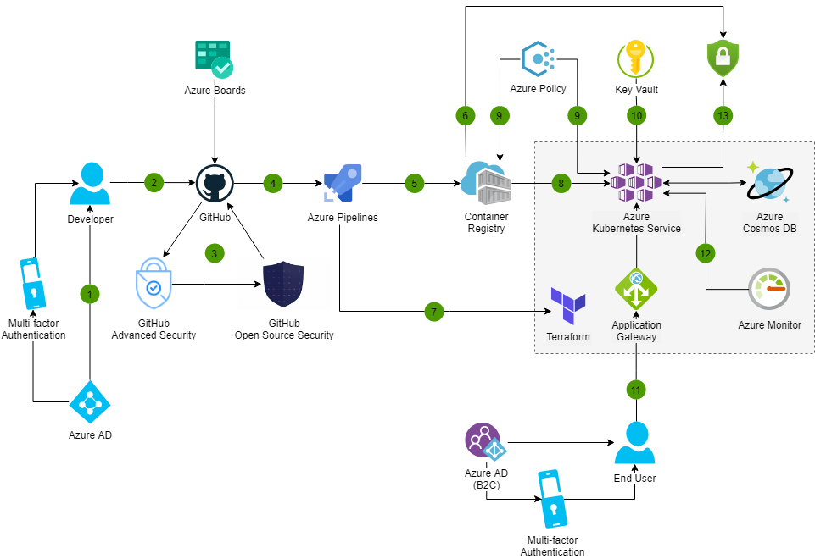
DevSecOps in Azure
DevSecOps in Azure - Azure Solution Ideas | Microsoft Docs
Learn Azure Policy for Kubernetes - Azure Policy | Microsoft Docs

Slide 36
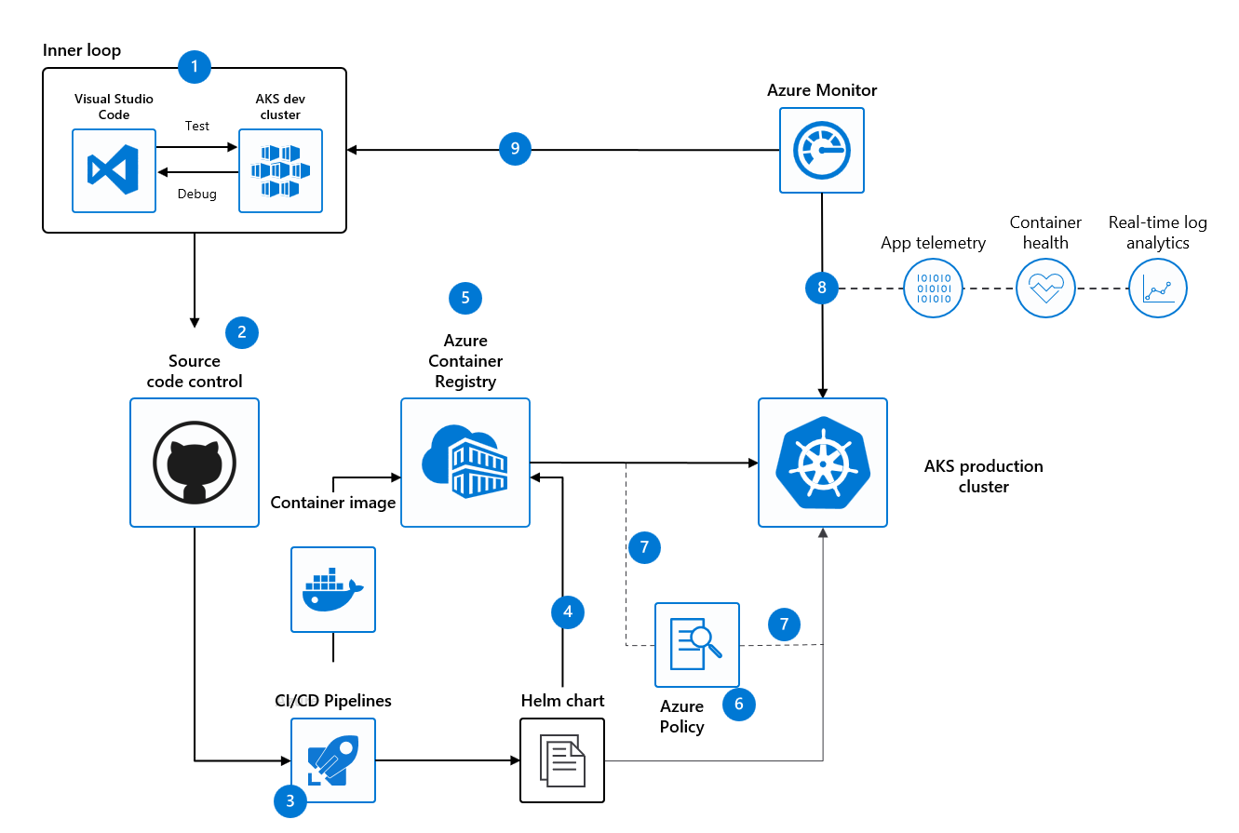
Secure DevOps for AKS
Secure DevOps for AKS - Azure Solution Ideas | Microsoft Docs
GitOps for Azure Kubernetes Service - Azure Example Scenarios | Microsoft Docs

Slide 37
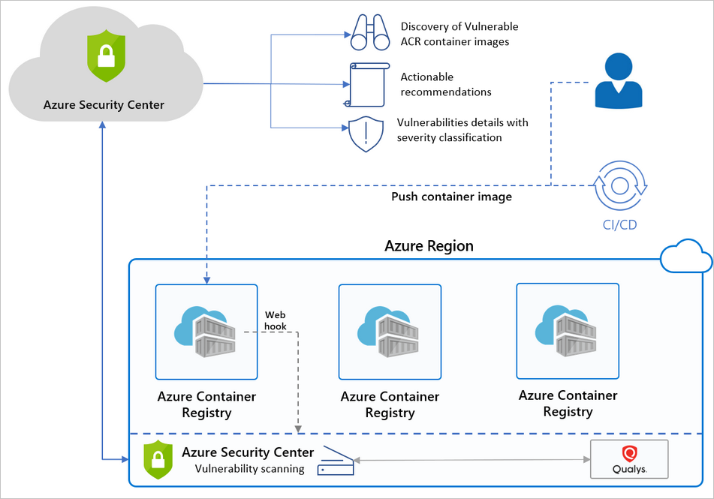
Microsoft Defender for Container Registries
Microsoft Defender for container registries - the benefits and features | Microsoft Docs

Slide 38
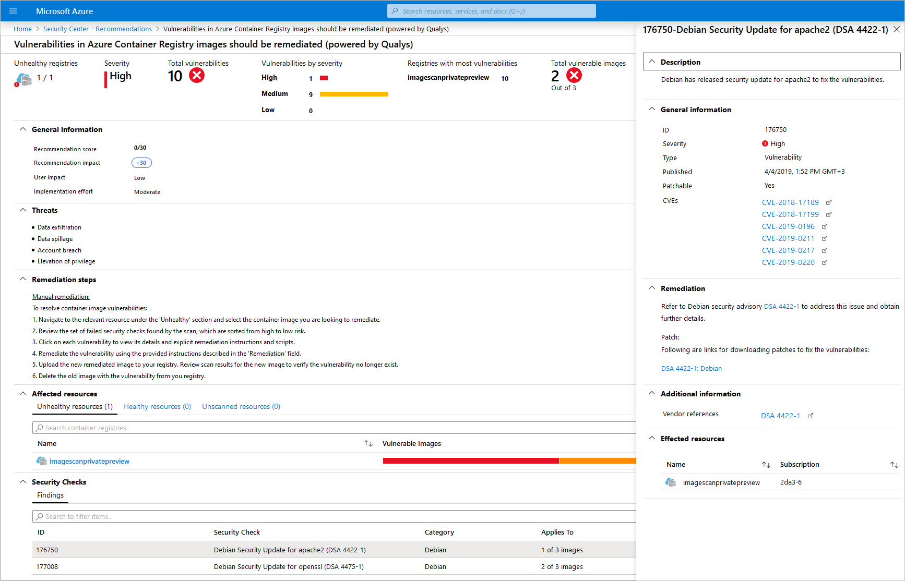
Microsoft Defender for Container Registries
Microsoft Defender for container registries - the benefits and features | Microsoft Docs
Defender for Cloud's vulnerability scanner for container images in CI/CD workflows | Microsoft Docs
Enhance your CI/CD deployment by using Vulnerability Assessments from Microsoft Defender for ACR - Microsoft Tech Community

Slide 39
Azure Defender for Containers
Azure Defender for container registries | Microsoft Docs
How to use Azure Defender for container registries | Microsoft Docs
GitHub Automation
Azure Defender's vulnerability scanner for container images in CI/CD workflows | Microsoft Docs
Azure DevOps Automation
Enhance your CI/CD deployment by using Vulnerability Assessments from Azure Defender for ACR - Microsoft Tech Community

Slide 40
The DevOps Process Security Practices
Pre-Commit
Threat Modeling
Commit (CI)
Static Code Analysis
Security Tests
Acceptance (CD)
Infra as Code
Dynamic Security Scanning
IDE Security Plug-ins
Secure Coding Standards
Peer Review
Dependency Management
Cloud Config. Validation
Security Acceptance Tests
Production
Security Smoke Tests
Configuration Checks
Live Site Penetration Testing
Operations
Continuous monitoring
Threat Intelligence
Penetration Testing
Blameless Post-Mortem
Red / Blue Team – War Games
Credential Scanning
DevSecOps controls - Cloud Adoption Framework | Microsoft Docs

Slide 41
The DevOps Process Tooling (Samples)
Pre-Commit
SDL & Threat Modeling
Commit (CI)
Static Code Analysis
Security Tests
Acceptance (CD)
Infra as Code
Dynamic Security Scanning
IDE Security Plug-ins
Secure Coding Standards
Peer Review
Dependency Management
Cloud Config. Validation
Security Acceptance Tests
Production
Security Smoke Tests
Configuration Checks
Live Site Penetration Testing
Operations
Continuous monitoring
Thread Intelligence
Penetration Testing
Blameless Post-Mortem
Red / Blue Team – War Games
Credential Scanning
OWASP Dependency-Check
WhiteSource
BinSkim
OWASP ZAP
Anchore – Container Scanning

Slide 42
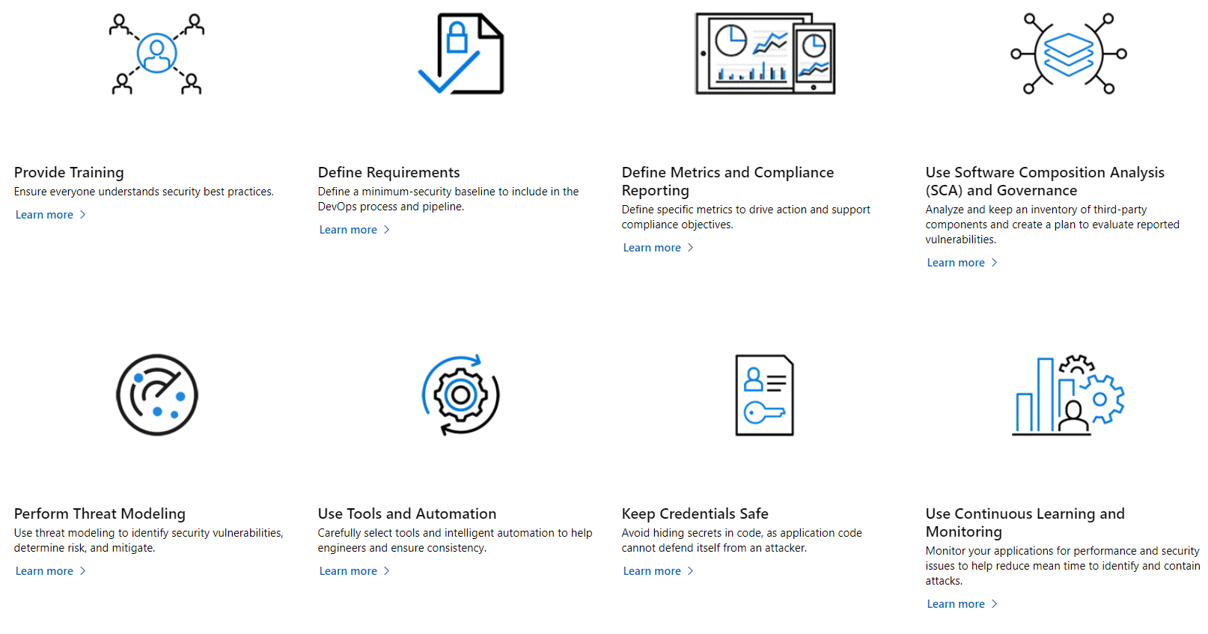
Lots of docs on Secure DevOps
Security in DevOps (DevSecOps) - Azure DevOps | Microsoft Docs
Secure development documentation on Microsoft Azure | Microsoft Docs
Microsoft Security Engineering
Microsoft Security DevOps

Slide 43
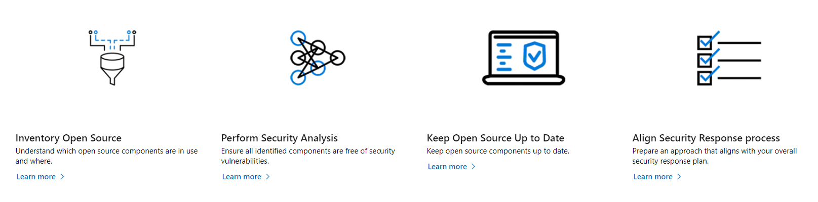
Using OpenSource
Microsoft Open Source Software Security

Slide 44
Secure your pipelines
Securing Azure Pipelines - Azure Pipelines | Microsoft Docs
Security through templates - Azure Pipelines | Microsoft Docs
Service connections in Azure Pipelines - Azure Pipelines | Microsoft Docs
Security hardening for GitHub Actions - GitHub Docs

Slide 45
GitHub Advance Security
About GitHub Advanced Security - GitHub Docs
Code Scanning
Secret Scanning
Dependency Review
GitHub Advanced Security is available for enterprise accounts on GitHub Enterprise Cloud and GitHub Enterprise Server. GitHub Advanced Security is also included in all public repositories on GitHub.com.

Slide 46
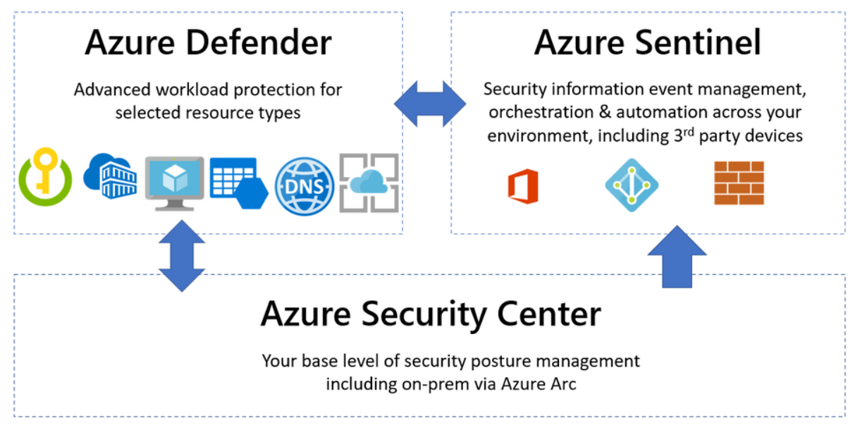
Continuos Monitoring for Security

Slide 47
What is your context?
What is the security experience on your devops team?
What tooling is available?
Depending on your context, look for practices that make the difference.
Few things – High Impact
Focus:
Static code Analysis
Dependency Management & Scanning
Dynamic Analysis
Security Scanning
Allow Time to Learn
Start in “Detection Mode”
Then move to “Prevention” (a.k.a. break pipelines)

Slide 48

More references
Overview of the Azure Security Benchmark v3 | Microsoft Docs
Azure Security Benchmark v3 - DevOps Security | Microsoft Docs
Security in DevOps (DevSecOps) describes the set of practices a team follows to build and maintain systems that are as secure as possible. - Azure DevOps | Microsoft Docs
devsecops/awesome-devsecops: An authoritative list of awesome devsecops tools with the help from community experiments and contributions. (github.com)
https://github.com/Azure/FTA-AppDevSecurity/tree/Initial
Security Baseline tools in Azure - Cloud Adoption Framework | Microsoft Docs
Microsoft Security DevOps
DevSecOps Tools and Services | Microsoft Azure
Microsoft Open Source Software Security
Microsoft Security Development Lifecycle Practices

Slide 49
More references
Build secure apps with collaborative DevSecOps practices (microsoft.com)
Ask the Experts: Build secure apps with collaborative DevSecOps practices (microsoft.com)
DevSecOps_Report_Tips_D6_fm.pdf (microsoft.com)
Collections - learncol | Microsoft Docs
DevSecOps: bringing security into your DevOps practice on Azure | Azure Enablement Show | Channel 9 (msdn.com)
DevSecOps: bringing security into your DevOps practice on Azure | Azure Enablement Show | Channel 9 (msdn.com)

